Slide 1
Vuejs’s Lifecycle and Utilities
I4GIC

Slide 2
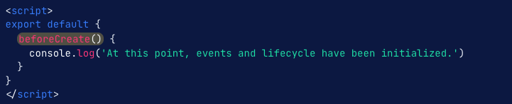
The lifecycle
Each of VueJs instance and components have their own life cycle:
beforeCreate : runs at the initialization of your component - data has not been made reactive, and events have not been set up yet

Slide 3
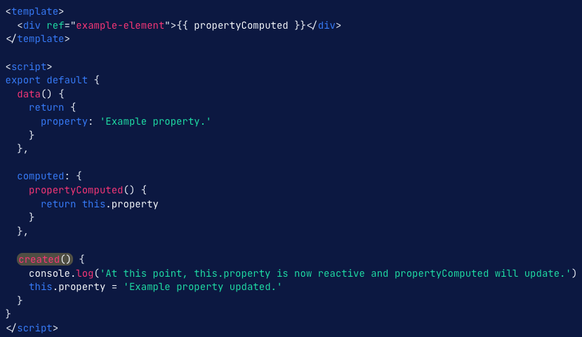
created: the created hook runs before the templates and Virtual DOM have been mounted or rendered - you are able to access reactive data and events that are active

Slide 4
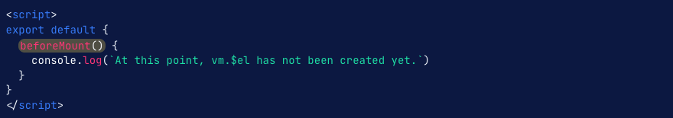
beforeMount: hook runs right before the initial render happens and after the template or render functions have been compiled.
Use created (or created and activated for keep-alive components) for this instead. Especially if you need that data during server-side rendering.

Slide 5
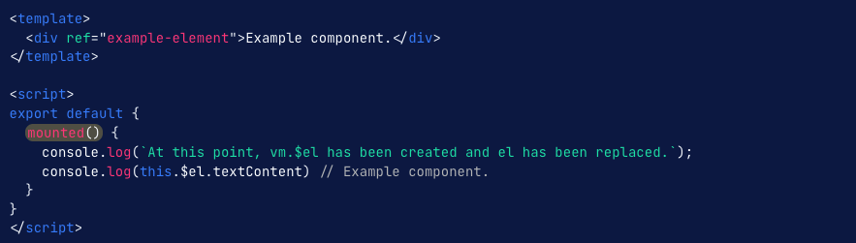
mounted: you will have full access to the reactive component, templates, and rendered DOM (via this.$el). Use mounted for modifying the DOM—particularly when integrating non-Vue libraries:
Use created (or created and activated for keep-alive components) for this instead. Especially if you need that data during server-side rendering.

Slide 6
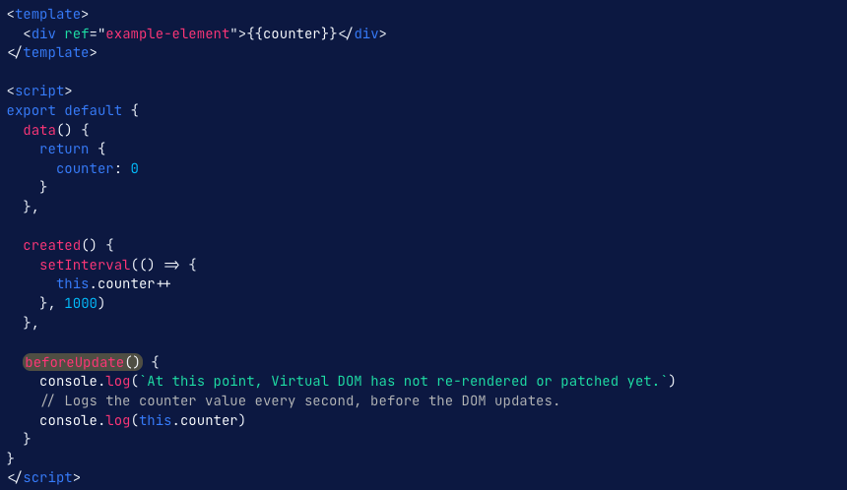
beforeUpdate: runs after data changes on your component and the update cycle begins, right before the DOM is patched and re-rendered.
Use beforeUpdate if you need to get the new state of any reactive data on your component before it gets rendered

Slide 7
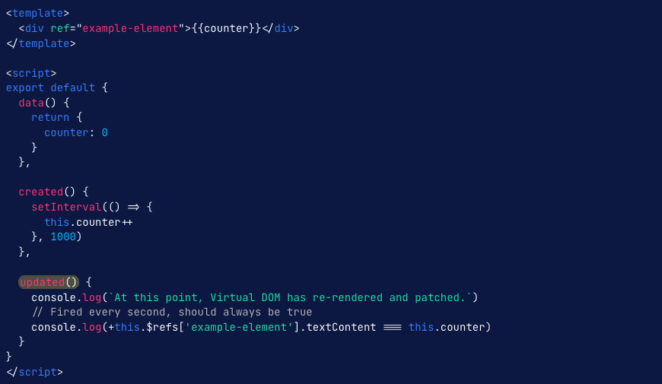
updated: runs after data changes on your component and the DOM re-renders.
Use updated if you need to access the DOM after a property change:

Slide 8
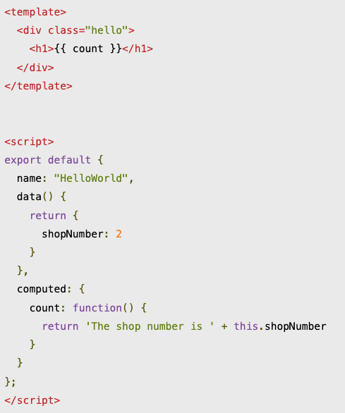
Computed property
Computed properties enable you to create a property that can be used to modify, manipulate, and display data within your components in a readable and efficient manner.

Slide 9
Computed property
How are computed properties used in VueJs:
Filtering data
Calculation
Boolean conditionals within the v-if
Using with mapGetters (function of vuex)

Slide 10
Watch property
Vue.js provides the watch property to observe and react to the variables or data change. We can use the watch property to:
Manipulate the DOM when the watched variable gets changed
Manipulate other data which depend on the watched variable
Trigger some actions

Slide 11
